Slide 1
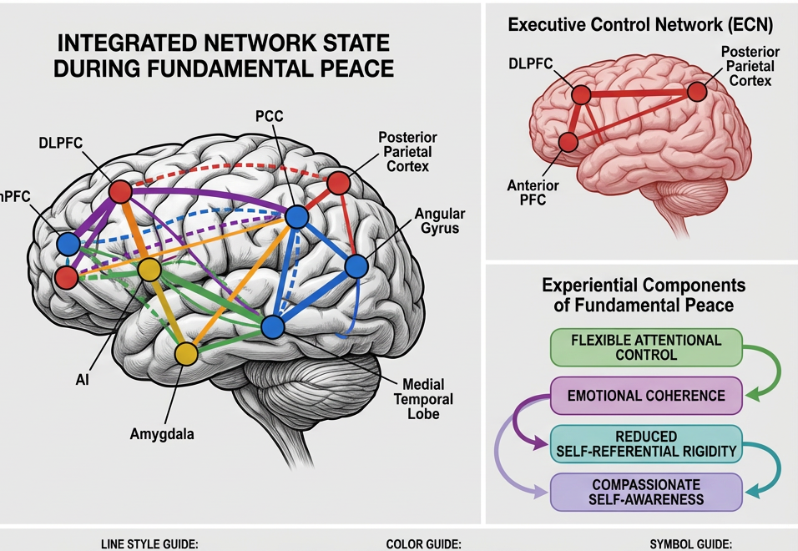
Hypnosis, Emotion
Regulation, and the Emergence
of Fundamental Peace
Presenting the model proposed in
Gallardo & Chetri, Behavioral Sciences 2026, 16, 395
Luis Miguel Gallardo • Saamdu Chetri
A mechanistic account linking network reconfiguration,
self-integration, and a measurable model of peace.
Source article: Gallardo & Chetri (2026)
01
Notes:
[Sources]
- Gallardo, L.M., & Chetri, S. (2026). Hypnosis as a Mechanism of Emotion Regulation and Self-Integration: An Integrative Review of Neural, Cognitive, and Experiential Pathways to Fundamental Peace. Behavioral Sciences, 16, 395. User-provided PDF.
- Figure 2 from the attached paper / author DOCX (published paper p. 18; original figure extracted from the DOCX media folder).
[/Sources]

Slide 2
From Clinical Hypnosis to Network Science
Context
The paper reframes hypnosis from a symptom-control technique to a psychobiological mechanism of regulation and self-integration.
Late 18th c.
1843
20th century
1990s–2020s
Mesmer
Braid
Erickson + Spiegel
Neuroimaging era
“Animal magnetism” opens the modern story of hypnosis.
Coins the term “hypnosis” and clarifies that it is not sleep.
Tailored induction, clinical utility, and the HIP assessment enter practice.
DMN, ECN, and SaN dynamics become central to theory.
Key shift in this review: hypnosis is treated as a coordinated change in attention, salience, and self-referential processing — not simply a set of therapeutic suggestions.
Gallardo & Chetri (2026)
02
Notes:
[Sources]
- Gallardo, L.M., & Chetri, S. (2026). Hypnosis as a Mechanism of Emotion Regulation and Self-Integration: An Integrative Review of Neural, Cognitive, and Experiential Pathways to Fundamental Peace. Behavioral Sciences, 16, 395. User-provided PDF. Historical background from Introduction §1.1 (pp. 1–2 of the PDF).
[/Sources]

Slide 3
Why This Review Was Needed
Problem
The article is motivated by four gaps in the hypnosis literature — and one integrative thesis.
1
Brain changes ≠ clinical model
2
Long-term regulation unclear
3
Wellness underdeveloped
4
No operational peace construct
Neural findings existed, but they were not coherently linked to mechanisms and outcomes.
The field explained acute symptom relief better than lasting shifts in self-regulation.
Most outcome work tracked symptom reduction more than integrated positive functioning.
Concepts like self-coherence lacked a clear empirical definition and measurement pathway.
Core thesis
Hypnotic induction reorganizes large-scale brain networks in ways that can improve emotion regulation, reduce dissociative fragmentation, and generate the integrated experiential state the paper calls Fundamental Peace.
FP definition
Mechanistic model
Measurement path
Testable predictions
A 4-component operational construct
Network → cognition → experience
Scales, tasks, neural markers
Clear future experiments
Gallardo & Chetri (2026)
03
Notes:
[Sources]
- Gallardo, L.M., & Chetri, S. (2026). Hypnosis as a Mechanism of Emotion Regulation and Self-Integration: An Integrative Review of Neural, Cognitive, and Experiential Pathways to Fundamental Peace. Behavioral Sciences, 16, 395. User-provided PDF. Rationale and knowledge gaps from Introduction §1.3 (pp. 3–4 of the PDF).
[/Sources]

Slide 4
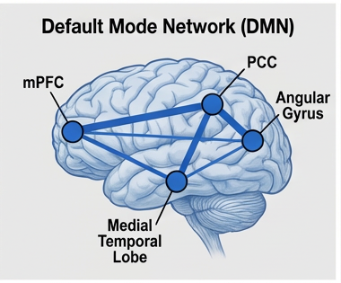
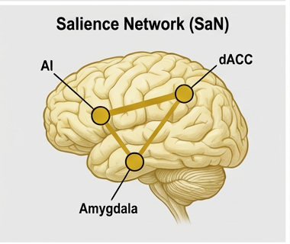
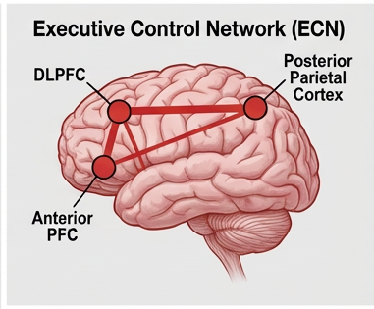
The Triple-Network Frame
Model
The paper uses Menon’s triple-network model to explain how hypnotic states reorganize cognition, emotion, and self-processing.
Default Mode Network (DMN)
Salience Network (SaN)
Executive Control Network (ECN)
Self-referential thought, autobiographical memory, mind-wandering, and a continuous sense of self.
Detects what matters right now and helps switch between internal and external modes.
Goal-directed attention, working memory, cognitive flexibility, and deliberate regulation.
Hypnosis is proposed to matter because it changes how these networks coordinate — especially by reducing DMN dominance and strengthening ECN–SaN coordination.
Gallardo & Chetri (2026)
04
Notes:
[Sources]
- Gallardo, L.M., & Chetri, S. (2026). Hypnosis as a Mechanism of Emotion Regulation and Self-Integration: An Integrative Review of Neural, Cognitive, and Experiential Pathways to Fundamental Peace. Behavioral Sciences, 16, 395. User-provided PDF. Triple-network model from §2.1–2.2 (pp. 4–6 of the PDF).
- Figure 2 from the attached paper / author DOCX (published paper p. 18; original figure extracted from the DOCX media folder). Cropped DMN, SaN, and ECN sub-panels are used as visual assets on this slide.
[/Sources]

Slide 5
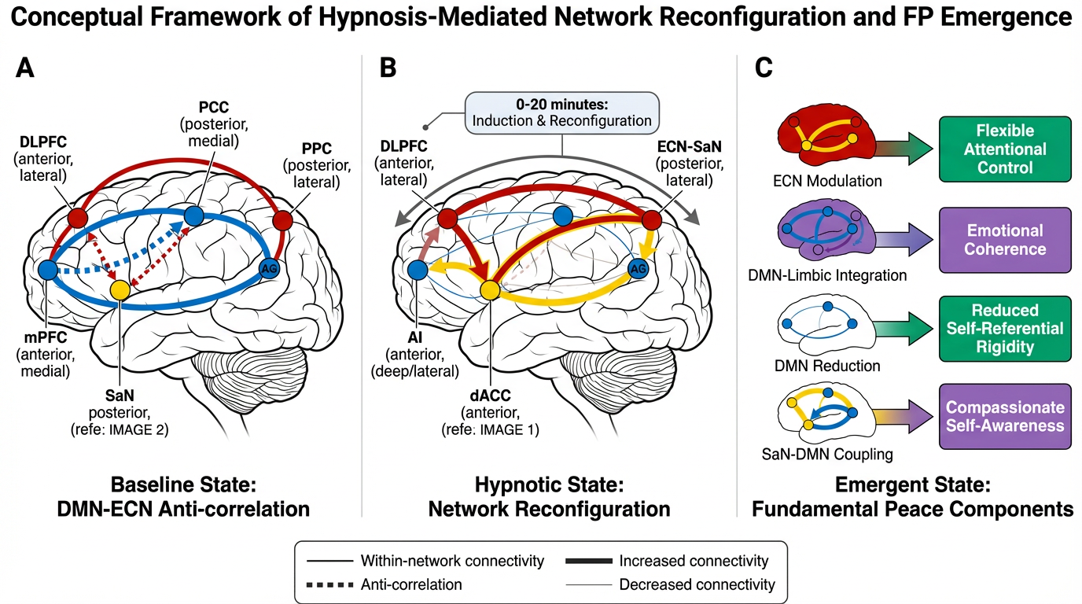
Figure 1 | Network Reconfiguration → Fundamental Peace
Figure
The paper’s first figure moves from baseline anti-correlation, to induction-driven reconfiguration, to the four experiential FP components.
A Baseline DMN–ECN anti-correlation
B Induction + reconfiguration
C Emergent FP components
Figure 1 from Gallardo & Chetri (2026)
05
Notes:
[Sources]
- Figure 1 from the attached paper / author DOCX (published paper p. 5; original figure extracted from the DOCX media folder).
- Gallardo, L.M., & Chetri, S. (2026). Hypnosis as a Mechanism of Emotion Regulation and Self-Integration: An Integrative Review of Neural, Cognitive, and Experiential Pathways to Fundamental Peace. Behavioral Sciences, 16, 395. User-provided PDF. Figure explained in §2 and §5.
[/Sources]

Slide 6
What the Evidence Base Already Supports
Evidence
The strongest quantitative evidence is for analgesia; the most theory-rich promise is for emotion regulation and trauma-related integration.
85
>3,600
Robust
controlled experimental trials
participants
pain reduction effects
meta-analysis of hypnotic pain relief
included in the Thompson et al. synthesis
moderated by hypnotic suggestibility
Evidence stream
Representative finding from the paper
What it supports
Neuroimaging
Hypnotic states reliably reduce DMN activity and often strengthen ECN–SaN coordination.
The network reconfiguration hypothesis.
Pain meta-analysis
Hypnotic analgesia shows consistent experimental pain reduction across paradigms.
Clinical potency is not just anecdotal.
Pediatric procedures
Evidence supports reduced anxiety, needle distress, pain, and peri-procedural burden.
Hypnosis is clinically versatile beyond adult pain.
Trauma / dysregulation
Clinical work suggests gains in dissociation and emotional dysregulation when carefully applied.
Integration mechanisms deserve direct testing.
Gallardo & Chetri (2026)
06
Notes:
[Sources]
- Gallardo, L.M., & Chetri, S. (2026). Hypnosis as a Mechanism of Emotion Regulation and Self-Integration: An Integrative Review of Neural, Cognitive, and Experiential Pathways to Fundamental Peace. Behavioral Sciences, 16, 395. User-provided PDF. Clinical evidence and meta-analytic summary from §1.2 and evidence evaluation in §6.
- The paper states that Thompson et al. (2019) synthesized 85 controlled trials with over 3600 participants.
[/Sources]

Slide 7
Individual Differences Matter: Suggestibility and Assessment
Assessment
Hypnotic responsiveness is trait-like, clinically relevant, and important for tailoring expectations and methods.
Instrument
Format
Time
Best use
Approximate population distribution
SHSS
Individual standardized induction + suggestions
~60 min
Research gold standard
HGSHS
Group administration
Shorter
Screening larger samples
Low
10–15%
Moderate
70–80%
High
10–15%
HIP
Brief clinical induction profile
5–10 min
Clinical tailoring and feasibility
Stronger responsiveness often predicts larger clinical effects — especially in analgesia — but low hypnotizability does not eliminate therapeutic benefit.
Clinical implication
• Use assessment to set expectations and choose induction style.
• HIP is especially practical when time is limited in medical or psychiatric settings.
• The paper emphasizes that clinical benefit is still possible without “classic” hypnotic phenomena.
Gallardo & Chetri (2026)
07
Notes:
[Sources]
- Gallardo, L.M., & Chetri, S. (2026). Hypnosis as a Mechanism of Emotion Regulation and Self-Integration: An Integrative Review of Neural, Cognitive, and Experiential Pathways to Fundamental Peace. Behavioral Sciences, 16, 395. User-provided PDF. Hypnotic suggestibility and assessment methods from §3 (pp. 7–8 of the PDF).
[/Sources]

Slide 8
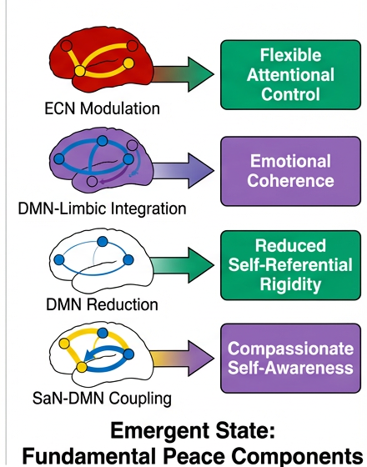
Fundamental Peace: The Paper’s Core Construct
FP
FP is defined as a dynamic state of integrated regulatory capacity — not merely calmness, positivity, or non-reactivity.
Working definition
“Integrated regulatory capacity under changing conditions.”
Operationally, the paper defines FP as a dynamic neuro-experiential state characterized by four mutually reinforcing qualities:
• flexible attentional control without effortful suppression
• emotional coherence across self-states
• reduced self-referential rigidity
• compassionate self-awareness
Not just equanimity. Not just well-being. Not just flow.
Gallardo & Chetri (2026)
08
Notes:
[Sources]
- Gallardo, L.M., & Chetri, S. (2026). Hypnosis as a Mechanism of Emotion Regulation and Self-Integration: An Integrative Review of Neural, Cognitive, and Experiential Pathways to Fundamental Peace. Behavioral Sciences, 16, 395. User-provided PDF. FP definition from §4.1–4.2 (pp. 9–11 of the PDF).
- Figure 1 from the attached paper / author DOCX (published paper p. 5; original figure extracted from the DOCX media folder). Panel C crop used on the right.
[/Sources]

Slide 9
Table 1 | FP Components, Neural Correlates, and Measures
Table
This is the operational heart of the paper: each FP component is tied to a distinct neural pattern and a concrete measurement strategy.
FP component
Operational definition
Neural correlate
Measurement approach
Flexible attentional control
Direct and sustain attention without continuous effortful suppression.
Enhanced ECN–SaN coupling; greater dlPFC–ACC coordination.
SART / ANT; attentional flexibility tasks; absorption scales.
Emotional coherence
Integration across self-states without dissociative fragmentation.
Flexible DMN–ECN connectivity; reduced rigid anti-correlation.
Narrative coherence coding; dissociation scales; autobiographical integration tasks.
Reduced self-referential rigidity
Less repetitive, rigid, self-focused thinking and rumination.
Reduced DMN activity in PCC / mPFC; lower DMN connectivity.
Rumination scales; self-concept flexibility; mind-wandering measures.
Compassionate self-awareness
Kind, non-judgmental observation of one’s own experience.
Reduced defensive processing; more balanced DMN–ECN coordination.
Self-compassion, self-critical response, and decentering measures.
Table 1 from Gallardo & Chetri (2026)
09
Notes:
[Sources]
- Gallardo, L.M., & Chetri, S. (2026). Hypnosis as a Mechanism of Emotion Regulation and Self-Integration: An Integrative Review of Neural, Cognitive, and Experiential Pathways to Fundamental Peace. Behavioral Sciences, 16, 395. User-provided PDF. Table 1 from §4.1 (pp. 9–10 of the PDF).
[/Sources]

Slide 10
Table 2 | How FP Differs from Related Constructs
Table
The paper positions FP as a dynamic regulatory capacity rather than a single mood state, evaluative judgment, or task-specific experience.
Reference point: FP = flexible attention + emotional coherence + reduced self-rigidity + compassionate self-awareness.
Construct
Main emphasis
Typical measure
What FP adds / changes
Equanimity
Even-minded non-reactivity; affective neutrality.
Equanimity scales; affect ratings.
FP includes active engagement and coherence across self-states — not neutrality alone.
Psychological well-being
Purpose, growth, mastery, positive self-evaluation.
Ryff Scales of Psychological Well-Being.
FP is regulatory capacity, not a global evaluation of life quality.
Nondual awareness
Awareness without subject–object division.
Nondual Awareness Dimensional Assessment.
FP retains functional self-awareness and emphasizes integration rather than dissolution.
Flow
Optimal task absorption with reduced self-consciousness.
Flow State Scale.
FP is not task-bound and includes coherence + compassion as core features.
Mindfulness
Present-moment attention with acceptance.
FFMQ, MAAS.
FP goes beyond present-focus by emphasizing cross-time coherence and self-integration.
Table 2 adapted from Gallardo & Chetri (2026)
10
Notes:
[Sources]
- Gallardo, L.M., & Chetri, S. (2026). Hypnosis as a Mechanism of Emotion Regulation and Self-Integration: An Integrative Review of Neural, Cognitive, and Experiential Pathways to Fundamental Peace. Behavioral Sciences, 16, 395. User-provided PDF. Table 2 and discussion in §4.2 (pp. 10–11 of the PDF).
[/Sources]

Slide 11
Measuring FP Now: Use a Multi-method Battery
Measurement
The paper is explicit: there is no validated FP scale yet, so measurement must triangulate across self-report, behavior, and neural markers.
Current best practice: build a component profile, not a single unvalidated FP score.
1 Self-report proxies
2 Behavioral & cognitive tasks
3 Neural & peripheral markers
• Five Facet Mindfulness Questionnaire (FFMQ)
• Self-Compassion Scale (SCS)
• Experiences Questionnaire (EQ)
• Absorption Scale
• SART / Attention Network Test
• Reappraisal and emotion interference tasks
• Self-reference / rumination paradigms
• Narrative coherence coding
• Resting-state DMN connectivity
• Task fMRI for ECN–SaN coupling
• EEG: frontal alpha asymmetry / midline theta
• HRV as an autonomic flexibility marker
Interpretation rule: combine subjective experience + task performance + network flexibility whenever possible.
Gallardo & Chetri (2026)
11
Notes:
[Sources]
- Gallardo, L.M., & Chetri, S. (2026). Hypnosis as a Mechanism of Emotion Regulation and Self-Integration: An Integrative Review of Neural, Cognitive, and Experiential Pathways to Fundamental Peace. Behavioral Sciences, 16, 395. User-provided PDF. Measurement approaches from §4.3 (pp. 11–12 of the PDF).
[/Sources]

Slide 12
A Practical FP Assessment Design
Measurement
A strong study or clinical protocol should assess FP across time — before, during, after, and beyond hypnotic work.
Baseline
In-session
Post-session
Follow-up
• HIP or SHSS/HGSHS
• FFMQ, SCS, EQ, Absorption
• Resting-state fMRI / EEG / HRV
• Brief state items on attention, coherence, compassion
• Hypnotic depth / responsiveness
• HRV or EEG where feasible
• Rumination / reappraisal change
• Narrative coherence or self-state integration
• Immediate symptom relief
• Repeated scale battery
• Resting-state flexibility
• Daily-life regulation and self-hypnosis access
Future need identified by the paper: a dedicated FP scale grounded in the 4-component model and validated psychometrically over time.
Gallardo & Chetri (2026)
12
Notes:
[Sources]
- Gallardo, L.M., & Chetri, S. (2026). Hypnosis as a Mechanism of Emotion Regulation and Self-Integration: An Integrative Review of Neural, Cognitive, and Experiential Pathways to Fundamental Peace. Behavioral Sciences, 16, 395. User-provided PDF. Derived from §4.3, §8.2, and future research directions §8.4.5 (measurement development).
- This slide is a presentation-level synthesis of the paper’s measurement recommendations rather than a direct figure from the manuscript.
[/Sources]

Slide 13
Mechanistic Model Overview
Mechanism
The model unfolds in three phases — sequential, but overlapping — from network reconfiguration to experiential integration.
Phase 1
Network reconfiguration
Phase 2
Cognitive–affective reorganization
Phase 3
Experiential integration
• DMN reduction
• ECN–SaN coupling
• More flexible DMN–ECN coordination
• Less rumination / rigid self-activation
• More attentional control
• More emotional flexibility
• Access to previously compartmentalized material
• Effortless attention
• Emotional coherence
• Flexible self-representation
• Compassionate self-awareness
FP emerges when the four experiential components begin to reinforce each other in a positive feedback loop.
Gallardo & Chetri (2026)
13
Notes:
[Sources]
- Gallardo, L.M., & Chetri, S. (2026). Hypnosis as a Mechanism of Emotion Regulation and Self-Integration: An Integrative Review of Neural, Cognitive, and Experiential Pathways to Fundamental Peace. Behavioral Sciences, 16, 395. User-provided PDF. Mechanistic model from §5.1–5.3 (pp. 12–15 of the PDF).
[/Sources]

Slide 14
Pathways 1–2: Attention and Self-rigidity
Mechanism
The first two pathways explain how hypnosis can loosen habitual self-focus and make attention both more stable and more effortless.
Pathway 1
Pathway 2
ECN–SaN coupling → flexible attentional control
DMN reduction → reduced self-referential rigidity
• Focused induction interrupts habitual self-focused loops in PCC / mPFC.
• This creates a window for more flexible self-representation and less rumination.
• Repeated practice may increase flexibility in when DMN patterns are engaged.
• Salience detection and goal-directed attention become more coordinated.
• Attention is experienced as focused yet relaxed — sustained without chronic suppression.
• That configuration may be ideal for learning, suggestion, and reorganization.
Measures: rumination, self-concept flexibility, mind-wandering, DMN connectivity
Measures: SART / ANT, absorption, frontal midline theta, ECN–SaN coupling
Gallardo & Chetri (2026)
14
Notes:
[Sources]
- Gallardo, L.M., & Chetri, S. (2026). Hypnosis as a Mechanism of Emotion Regulation and Self-Integration: An Integrative Review of Neural, Cognitive, and Experiential Pathways to Fundamental Peace. Behavioral Sciences, 16, 395. User-provided PDF. Detailed pathways from §5.2.1–5.2.2 and linkage to FP in §8.2.
- Figure 2 from the attached paper / author DOCX (published paper p. 18; original figure extracted from the DOCX media folder). Cropped DMN, SaN, and ECN sub-panels are used as visual assets.
[/Sources]

Slide 15
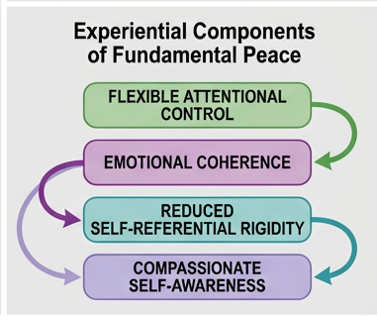
Pathways 3–4: Coherence and Compassion
Mechanism
The second pair of pathways explains how altered network coordination can reduce fragmentation and support kinder, more integrated self-awareness.
Pathway 3
Pathway 4
Altered DMN–ECN connectivity → emotional coherence
Reduced defensive processing → compassionate self-awareness
• Less rigid anti-correlation allows emotional memory and regulatory control to co-occur.
• This may help integrate dissociated or compartmentalized experience.
• The subjective outcome is continuity across self-states rather than fragmentation.
• Absorbed, decentered states may lower the need for defensive distortion.
• This creates space for honest self-observation with less identification and reactivity.
• Self-compassion becomes more accessible because the observing stance is kinder and less threatened.
Measures: dissociation, narrative coherence, autobiographical integration, DMN–ECN flexibility
Measures: self-compassion, decentering, self-critical responses, self-evaluation tasks
Gallardo & Chetri (2026)
15
Notes:
[Sources]
- Gallardo, L.M., & Chetri, S. (2026). Hypnosis as a Mechanism of Emotion Regulation and Self-Integration: An Integrative Review of Neural, Cognitive, and Experiential Pathways to Fundamental Peace. Behavioral Sciences, 16, 395. User-provided PDF. Detailed pathways from §5.2.3–5.2.4 and explicit linkage to FP emergence in §8.2.
- Figure 2 from the attached paper / author DOCX (published paper p. 18; original figure extracted from the DOCX media folder). Experiential-components crop used as a visual anchor on the right.
[/Sources]

Slide 16
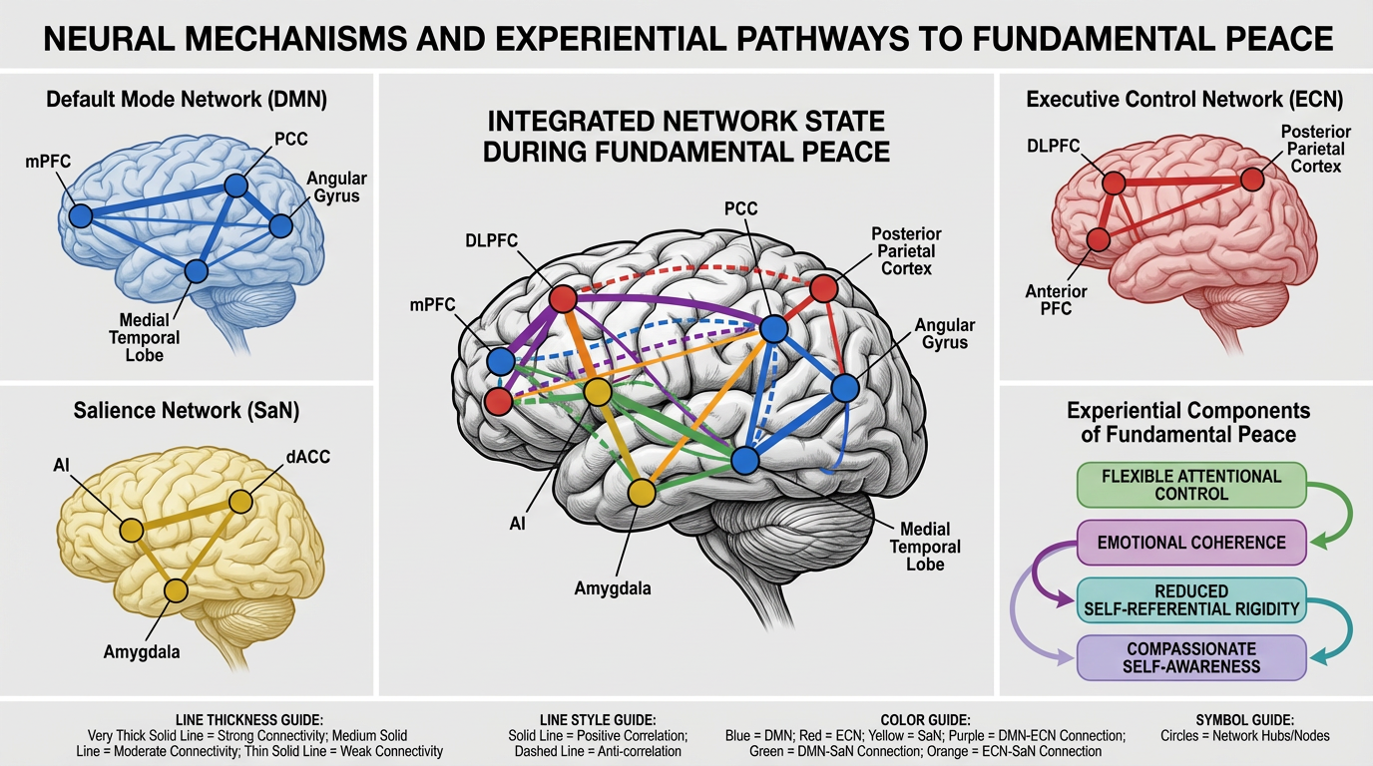
Figure 2 | Integrated Network State during FP
Figure
The second figure depicts FP not as one region “turning on”, but as a flexible configuration across networks and experiential loops.
Figure 2 from Gallardo & Chetri (2026)
16
Notes:
[Sources]
- Figure 2 from the attached paper / author DOCX (published paper p. 18; original figure extracted from the DOCX media folder).
- Gallardo, L.M., & Chetri, S. (2026). Hypnosis as a Mechanism of Emotion Regulation and Self-Integration: An Integrative Review of Neural, Cognitive, and Experiential Pathways to Fundamental Peace. Behavioral Sciences, 16, 395. User-provided PDF. Figure explained in §6.2 and linked back to FP emergence in §8.2.
[/Sources]

Slide 17
What the Model Predicts — and What Modulates It
Predictions
A strength of the paper is that it offers direct, falsifiable predictions rather than only a conceptual metaphor.
Six testable predictions
Key moderators
1
Greater DMN reduction should predict lower self-rigidity and rumination.
4
The four FP components should correlate and outperform any one component alone.
Hypnotic suggestibility
2
Enhancing ECN–SaN coupling should increase hypnotic responsiveness and FP access.
5
Self-hypnosis practice should shift resting-state flexibility over time.
Baseline network organization
Trauma history / dissociative tendencies
3
Trauma-related dissociation should map onto altered baseline DMN–ECN patterns.
6
Network reconfiguration should mediate clinical gains beyond baseline suggestibility.
Therapeutic alliance and context
These factors should shape who benefits, how strongly, and through which pathways.
Gallardo & Chetri (2026)
17
Notes:
[Sources]
- Gallardo, L.M., & Chetri, S. (2026). Hypnosis as a Mechanism of Emotion Regulation and Self-Integration: An Integrative Review of Neural, Cognitive, and Experiential Pathways to Fundamental Peace. Behavioral Sciences, 16, 395. User-provided PDF. Testable predictions from §6.3 and moderators from §5.4 (pp. 15–19 of the PDF).
[/Sources]

Slide 18
Clinical Applications and Implementation
Practice
The paper’s model matters clinically because it suggests how hypnosis may support integration, not just immediate symptom relief.
Trauma treatment
Emotion-regulation training
Integration with therapies
• Work within a “window of tolerance”.
• Facilitate communication across dissociated self-states / ego states.
• Anchor internal safe places and self-regulatory resources.
• Practice reappraisal under hypnosis.
• Use somatic regulation and autonomic down-shifting.
• Build compassionate self-talk and self-hypnosis skills.
• CBT and exposure work
• Mindfulness-based approaches
• Psychodynamic and somatic therapies
Implementation caution: formal hypnosis training is recommended in general, and trauma-focused work requires specialized trauma-informed expertise and supervision.
Gallardo & Chetri (2026)
18
Notes:
[Sources]
- Gallardo, L.M., & Chetri, S. (2026). Hypnosis as a Mechanism of Emotion Regulation and Self-Integration: An Integrative Review of Neural, Cognitive, and Experiential Pathways to Fundamental Peace. Behavioral Sciences, 16, 395. User-provided PDF. Clinical applications from §7 (pp. 19–21 of the PDF).
[/Sources]

Slide 19
Limits, Ethics, and Cultural Scope
Critical view
The paper is ambitious, but it explicitly acknowledges where the evidence is thin and where careful ethical practice matters.
Evidence limits
Ethical safeguards
Cultural scope
• Most hypnosis neuroimaging studies remain small and underpowered.
• Induction methods, suggestions, and control conditions are heterogeneous.
• Causal relationships between network changes and experience still need direct tests.
• Use informed consent and address myths about “loss of control”.
• Avoid suggestive memory work that risks false memories.
• Watch for dependency, boundary issues, and scope-of-practice problems.
• The model is built mainly from WEIRD samples.
• Self-integration may not be valued or conceptualized the same way across cultures.
• Measures and interventions need cross-cultural validation and adaptation.
Gallardo & Chetri (2026)
19
Notes:
[Sources]
- Gallardo, L.M., & Chetri, S. (2026). Hypnosis as a Mechanism of Emotion Regulation and Self-Integration: An Integrative Review of Neural, Cognitive, and Experiential Pathways to Fundamental Peace. Behavioral Sciences, 16, 395. User-provided PDF. Limitations from §6.1 and §8.1; ethical and cultural issues from §8.3 (pp. 16, 21–24 of the PDF).
[/Sources]

Slide 20
Take-home Message
Close
The paper leaves us with a research program: define FP clearly, measure it rigorously, and test whether hypnotic practice reliably grows it.
Four takeaways
1
Hypnosis may operate as a mechanism of large-scale network reconfiguration — not only as symptom suggestion.
2
Fundamental Peace is a dynamic, integrated regulatory capacity under changing conditions.
3
Measure FP with multi-method profiles now; build a validated FP scale next.
4
The highest-value tests are longitudinal, mechanistic, and cross-cultural.
“Unlike equanimity or well-being, Fundamental Peace represents integrated regulatory capacity under changing conditions.”
Questions?
Gallardo & Chetri (2026)
20
Notes:
[Sources]
- Gallardo, L.M., & Chetri, S. (2026). Hypnosis as a Mechanism of Emotion Regulation and Self-Integration: An Integrative Review of Neural, Cognitive, and Experiential Pathways to Fundamental Peace. Behavioral Sciences, 16, 395. User-provided PDF. Conclusion and FP definition from Abstract, §4, and §9.
[/Sources]

